Slide 1
Presentation to Islands Trust Council
December 6, 2017 – Victoria, BC

Slide 2
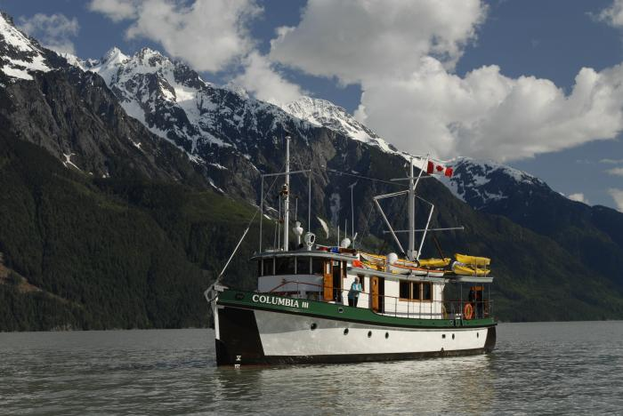
Context
As a trading nation, marine transportation is a key driver for Canada.
Provides Northern and remote communities with food and other essential goods
Employs approximately 250,000 Canadians
  In recent years, areas for improvement in marine safety, oceans issues and environmental protection have been identified through regulatory reviews, reports, project and policy consultations, expert panels, etc.
  Much of this feedback has come from First Nations, and we have been listening.

Slide 3
What is the Oceans Protection Plan?
$1.5 billion, 5 year national Oceans Protection Plan (OPP) will:
Improve marine safety and responsible shipping
Protect Canada’s marine environment
Strengthen partnerships with Indigenous communities
Invest in science for evidence-based decision-making
Between 2017-2022, over 50 initiatives will be delivered to meet these goals.
A World-Leading Marine Safety System
Preserve and Restore Marine Ecosystems
Prevention
Response
Indigenous Partnerships
Stronger Evidence Base

Slide 4
How is the Oceans Protection Plan organized?
Transport Canada
Fisheries and Oceans Canada
Canadian Coast Guard
Environment and Climate Change Canada
Natural Resources Canada
in partnership with…
Indigenous Groups
Marine Industry
Scientific Community
Local Communities
Other Stakeholders
and collaboration with…

Slide 5

Initiatives under the Oceans Protection Plan
Response: Preparing for and Responding to Emergencies
Indigenous Partnerships
Stronger Evidence Base
Preserving and Restoring Marine Ecosystems
Prevention: Managing Waterways for Safety
  Oceans Protection Plan initiatives range across the four priority areas.
  Some initiatives involve multiple departments/agencies.
  Many are linked to other initiatives.
  Complex environment; will use a variety of methods to engage.

Slide 6
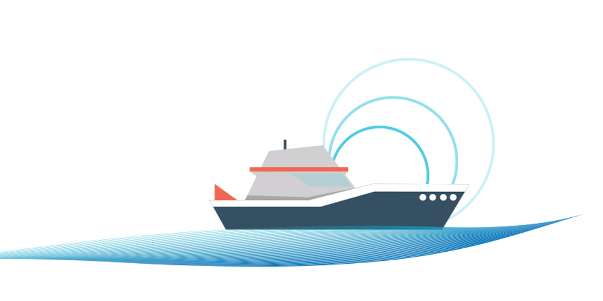
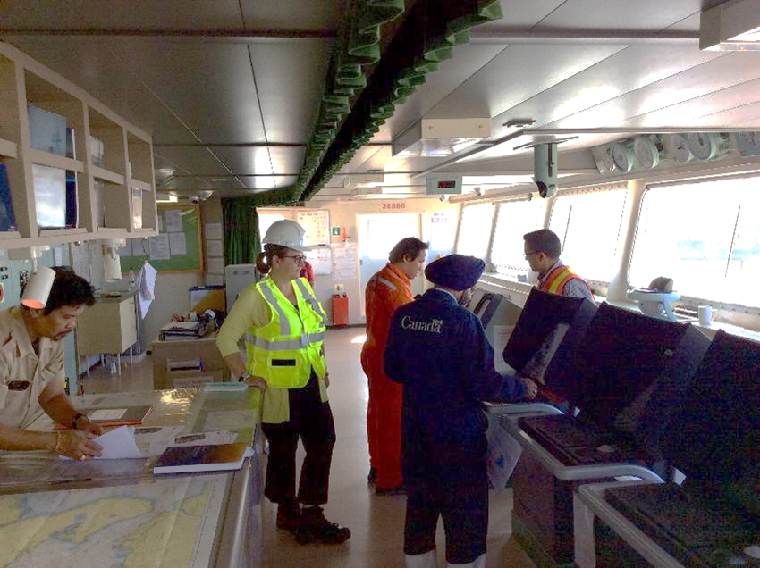
Prevention: Managing Waterways for Safety
Better Information Sharing
Enhanced Marine Situational Awareness
  New marine information sharing system
Proactive Vessel Management & Anchorages
  More collaborative approach to identifying & managing marine traffic issues
More radar capacity for safer navigation
Notes:
Photo Credit: Canadian Coast Guard

Slide 7
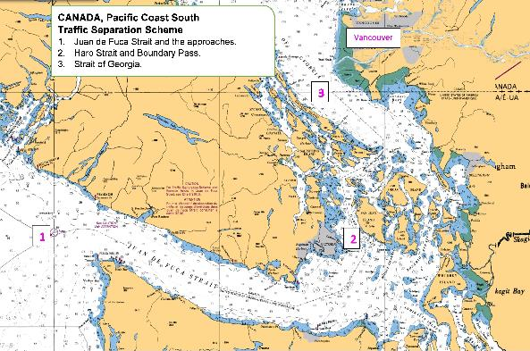
Prevention: Managing Waterways for Safety
Safer Navigation
Modernizing Pilotage Act
Modern hydrography and charting in higher traffic areas
Enhanced marine weather forecasting

Slide 8
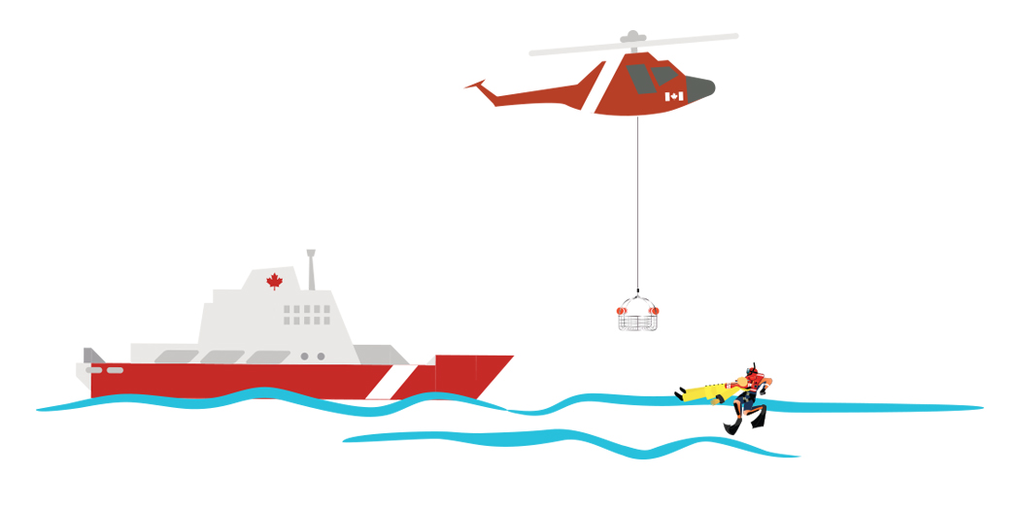
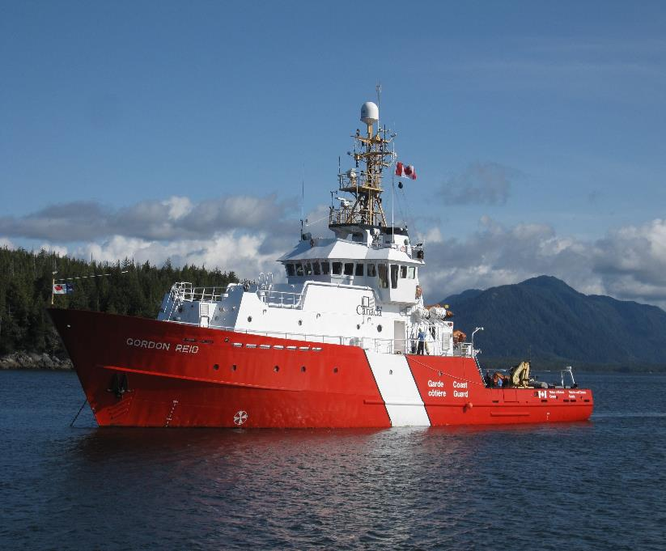
Response: Preparing for and Responding to Emergencies
Proactive monitoring and response capacity
Establish 24/7 response capacity
  Enhance CCG Regional Operations Centre & TC Situation Centre; add regional Environmental Emergency Officers
Modernize response equipment
  Upgrade assets like booms, vessels, and clean-up technologies
  New mobile command posts and communications equipment
New logistics depot
  In Port Hardy, to house environmental response staff and equipment for rapid response to spills

Slide 9
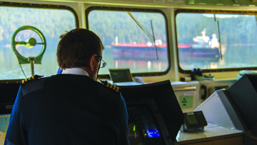
Response: Preparing for and Responding to Emergencies
Proactive monitoring and response capacity
Enhanced search and rescue capacity
  Four new lifeboat stations on the west coast
Increased emergency tow capacity
  Install towing equipment on all major Coast Guard vessels
  Lease two offshore vessels capable of emergency response towing of large ships on the west coast
  Engage Indigenous Groups, and other key stakeholders to complete a needs analysis study (Winter 2017).

Slide 10
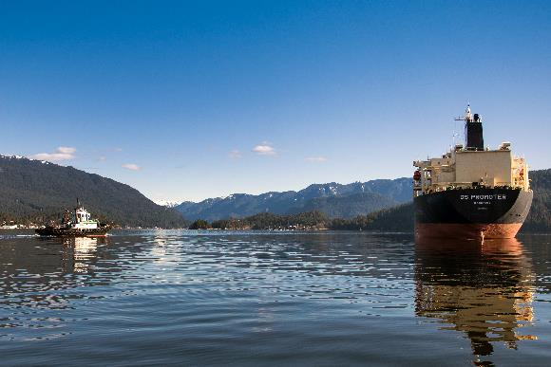
Response: Preparing for and Responding to Emergencies
More collaborative and inclusive process and better quality decisions
Places of Refuge Planning
  Where a ship in need of assistance can go to stabilize and reduce hazard; not a designated anchorage
  Work with Indigenous and coastal communities to expand the existing plan and include more sub-regions (Haida Gwaii recently concluded), starting in Winter 2017.
Strengthen polluter-pay principle by updating Ship-Source Oil Pollution Fund

Slide 11

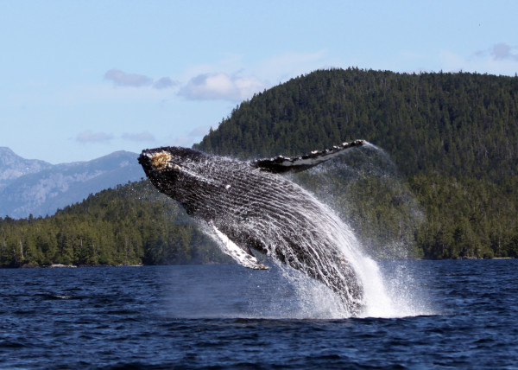
Preserving and Restoring Marine Ecosystems
Assessing Cumulative Effects of Marine Shipping, and Coastal Environmental Baseline Program
  In collaboration with partners, develop a framework to assess cumulative effects, and collect data in 6 pilot areas, including Vancouver and Prince Rupert
Protecting marine mammals, particularly whales
  Understand stressors and introduce strategies to mitigate impacts from vessels; detect and avoid marine mammals; and respond effectively.
Coastal Restoration Fund
  Support local habitat restoration projects
Marine Spatial Planning
  North and central coast

Slide 12
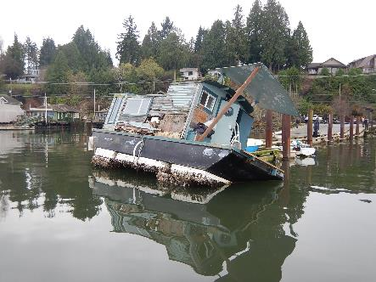
Preserving and Restoring Marine Ecosystems
  National Strategy on Abandoned and Wrecked Vessels
      Short-term funding programs for vessel removals, education and research
      New legislation to prohibit vessel abandonment
      Enhancing commercial vessel and pleasure craft owner identification systems
      A national inventory of abandoned and wrecked vessels, prioritized according to risk
      Vessel-owner financed funds to remediate wrecked, abandoned and hazardous vessels in the longer term

Slide 13

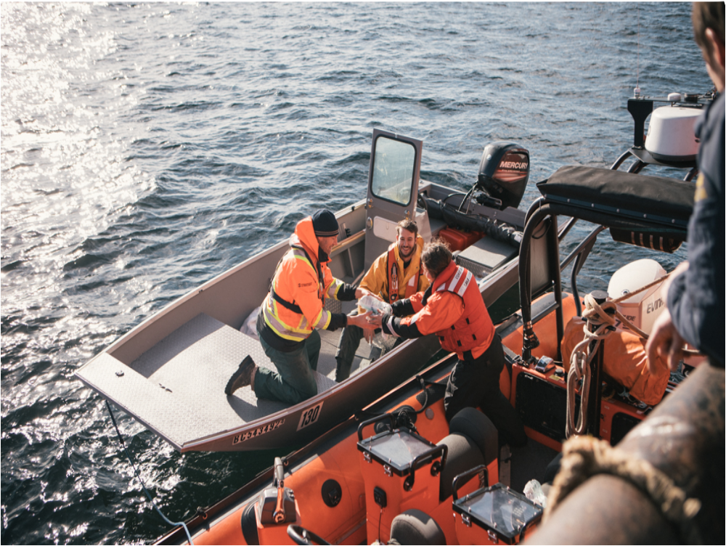
Indigenous Partnerships
Advancing reconciliation by building partnerships with Indigenous groups in a number of areas including:
  understanding effects of shipping;
  creating local vessel control areas to minimize safety risks and/or environmental impacts;
  updating and modernizing regulations and other tools to respond to local issues related to marine traffic;
  taking most appropriate measures when monitoring clean-up, in the event of a spill; and
  training programs to increase participation of Indigenous group members, particularly women, in marine safety jobs.

Slide 14
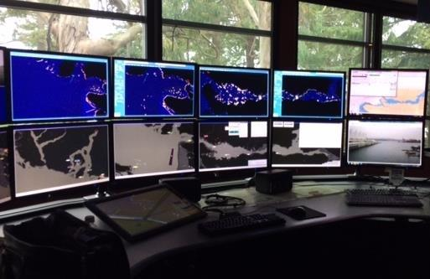
Stronger Evidence Base
Scientific research to improve understanding of how oil behaves in water and how to clean it up:
  Improved oil spill trajectory models
  Studying behaviour, fate and biological impact of oil in water
  Research on spill response technologies
  Support for real time digital hydrophone and oceanographic technologies through Oceans Network Canada

Slide 15
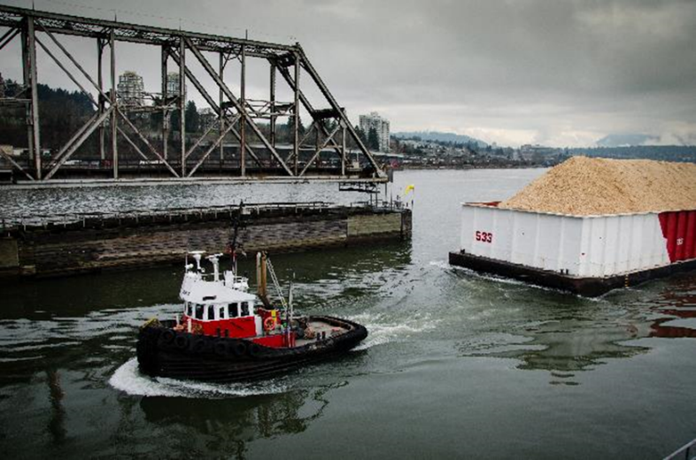
Questions & Contacts
For more information:
Lorraine Gill, Transport Canada Lorraine.gill@tc.gc.ca

